Slide 1
CH 10 Symbol Table and Block Structure
鄭永斌 教授

Slide 2
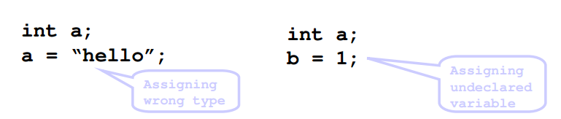
Semantic
Semantic analysis checks that identifiers are used appropriately within the program as a whole (globally)

Slide 3
What to check?
For semantic checking, we need to check whether:
Variable not declared multiple times
Variable declared before assigned
Variable assigned before referenced
Assignment compatible with declared type
Operations on variables compatible with type

Slide 4
Symbol Table :
In a compiler: a data structure used by the compiler to keep track of identifiers used in the source program.This is a compile-time data structure. Not used at run time.
In object files: a symbol table (mapping var name to address) can be build into object programs, to be used during linking of different object programs to resolve reference.
In executables: a symbol table (again mapping name to address) can be included in executables, to recover variable names during debugging.
Our Focus: Symbol table in compiler

Slide 5
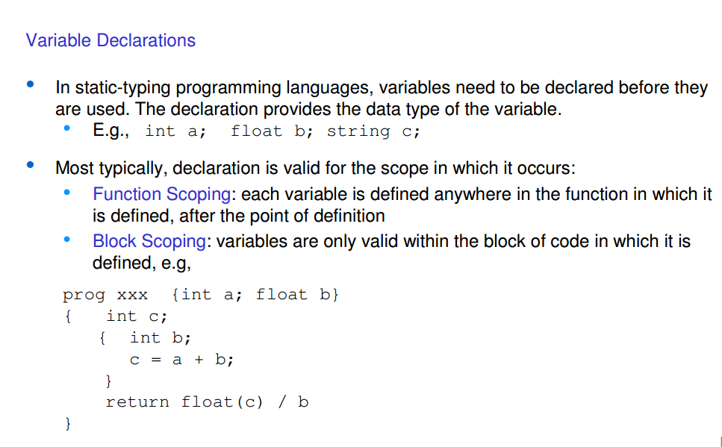

Slide 6
NOTES
So, in yacc grammar, at variable declaration non-terminals
You need to add the procedure to store information into symbol tables.
You can trace the symbol table related source code from here.
more precisely, when the AST of variable declarations are evaluated, you need to start adding/inquiring information from symbol table

Slide 7
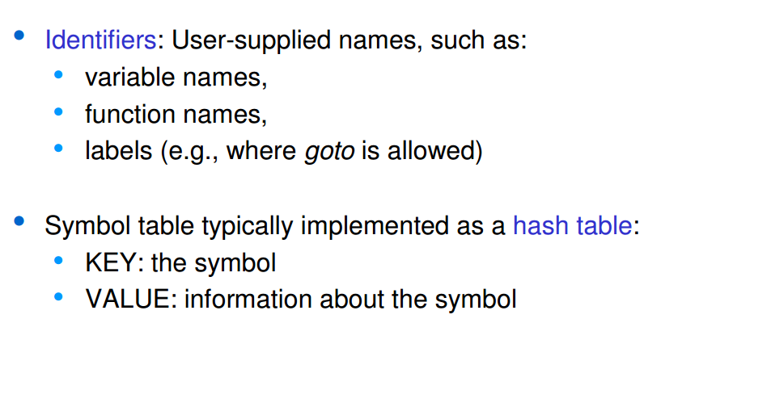
Symbol Table

Slide 8
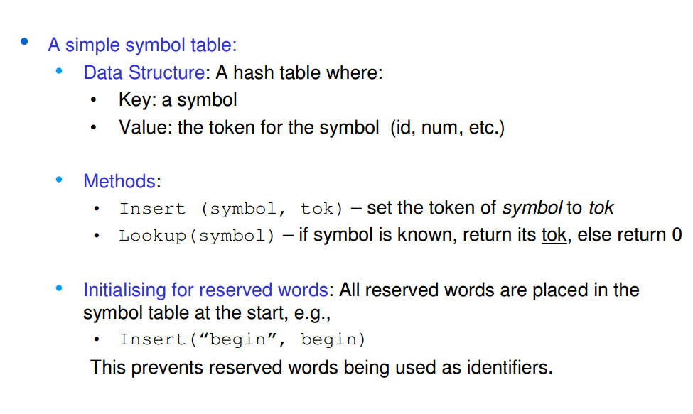
Symbol Table

Slide 9
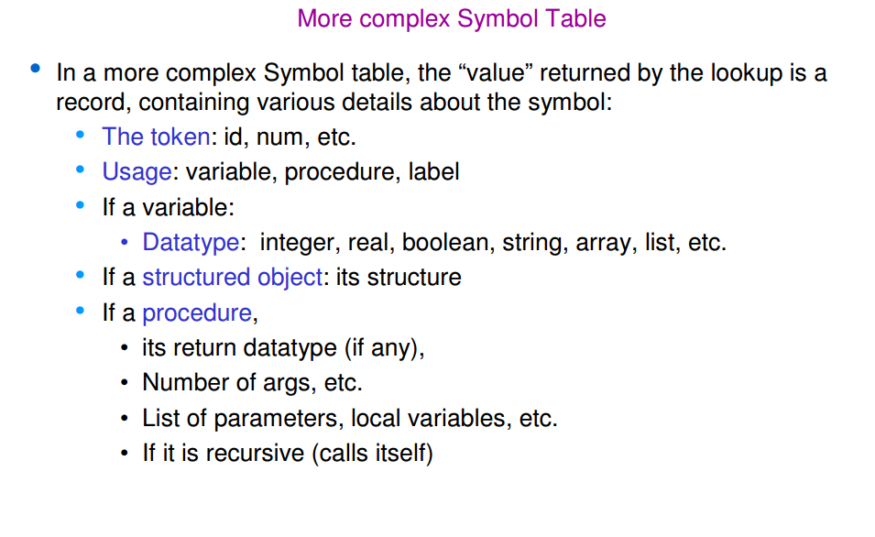
Symbol Table

Slide 10
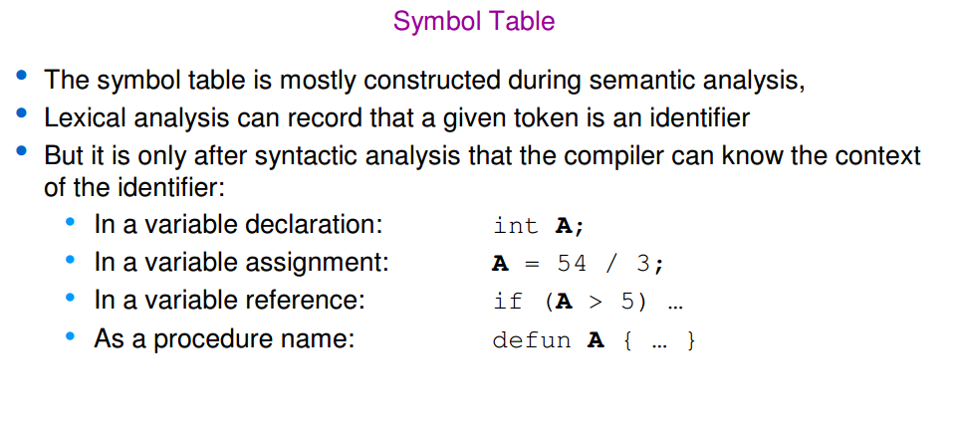

Slide 11
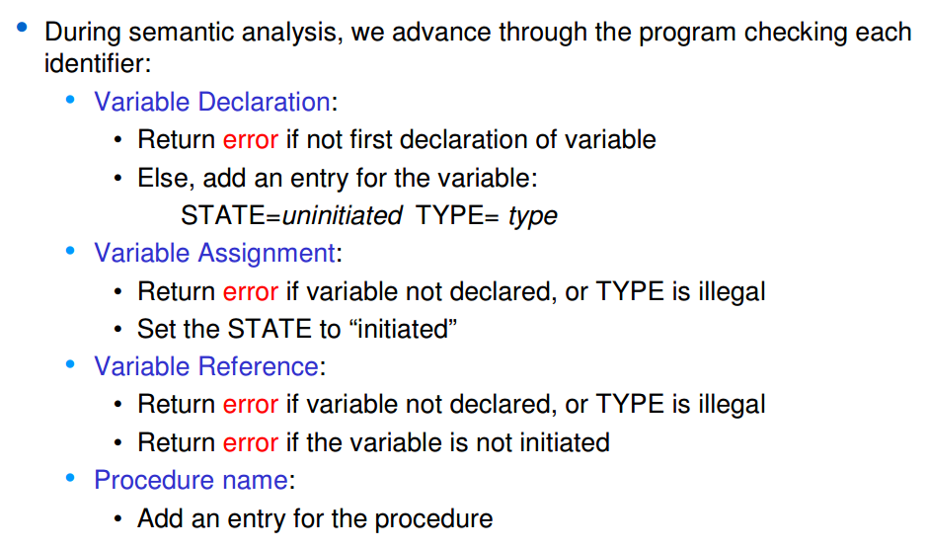
What to Check? with Symbol Table

Slide 12
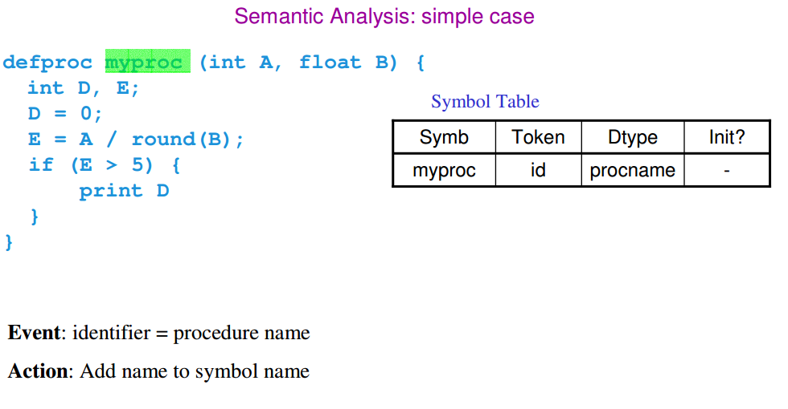

Slide 13
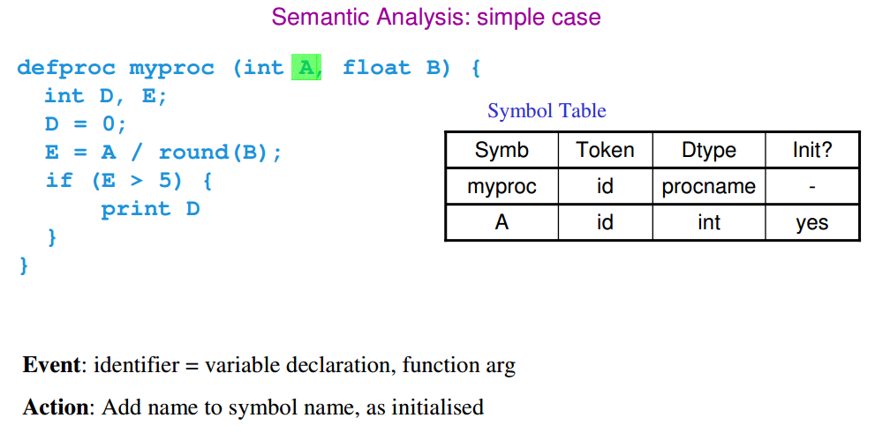

Slide 14
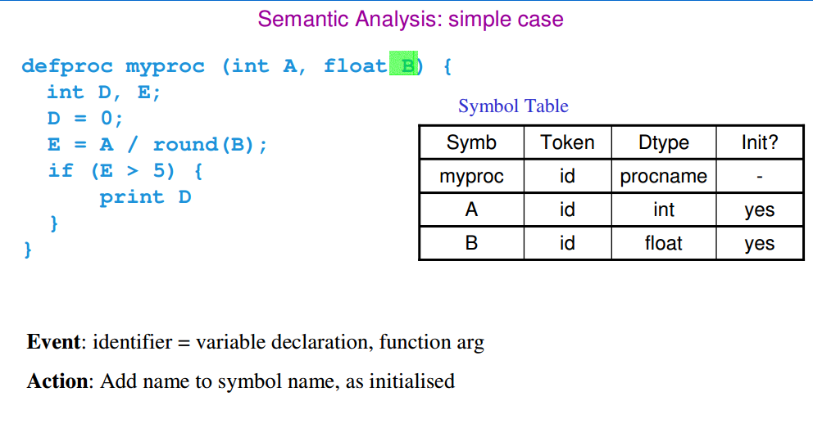

Slide 15
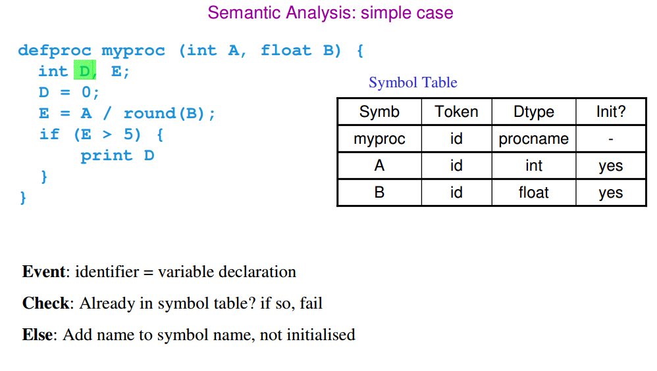

Slide 16
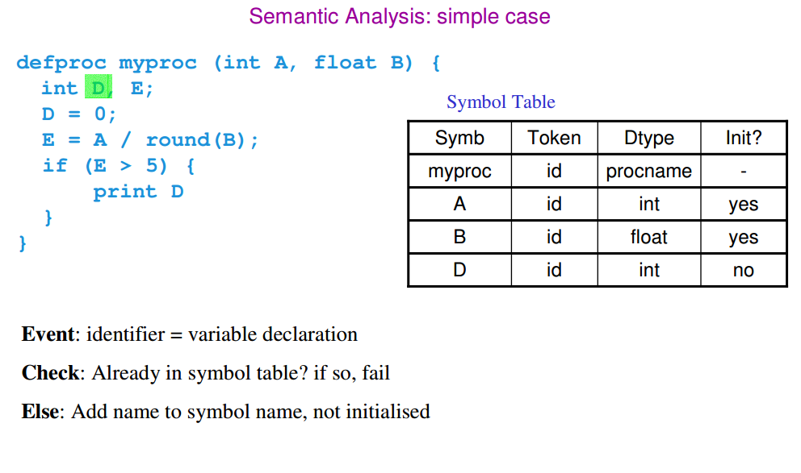

Slide 17
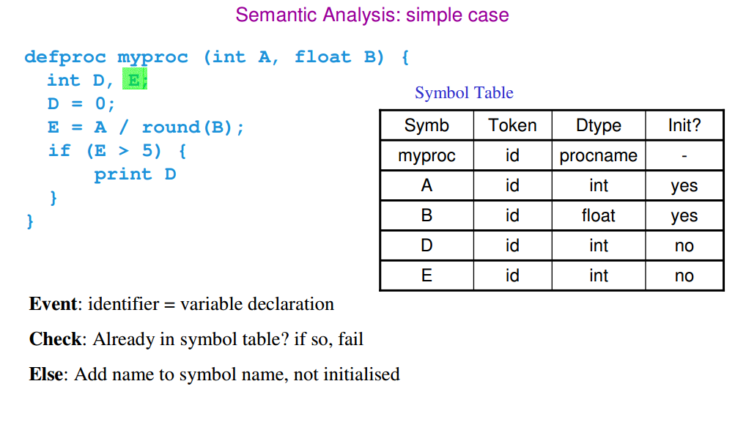

Slide 18
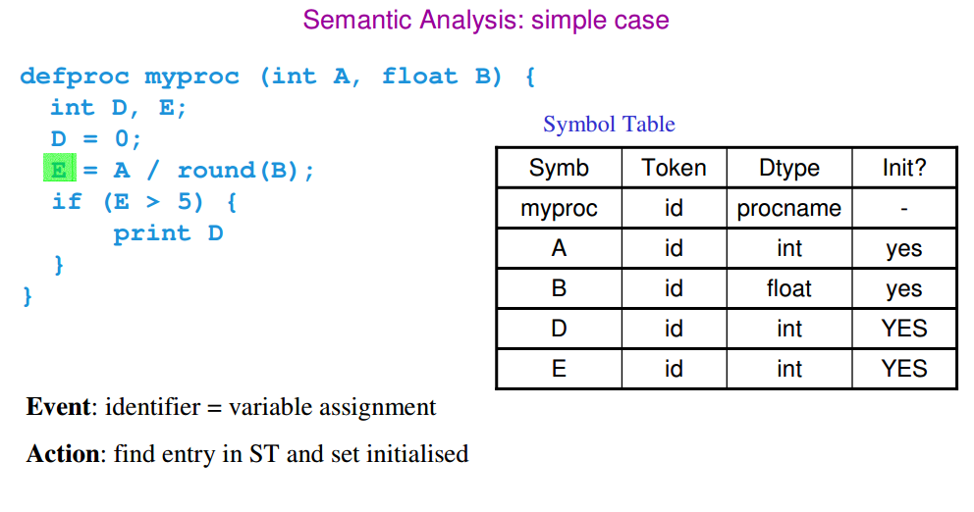

Slide 19
Blocked-Structured Symbol Tables
Most programming languages have name scopes to be nested
Name scope: program text enclosed by a program unit such as subprogram, package, or a block
Programming language with nested name scopes are known as block-structured languages

Slide 20
Nested Scope example
Declare
H, A, L : integer
Begin
declare
X,Y : real ;
begin
…..
end
declare
A,C,M : Character;
begin
…
end;
End;

Slide 21
Declare
H, A, L : integer // open scope
Begin
declare
X,Y : real ;
begin
….. // closed scope
end
declare
A,C,M : Character;
begin
…
… // current position in program (current scope)
…
end;
End;

Slide 22
Visibility rules
Only names in current scope and open scopes are accessible
If name is declared in more than one open scopes, the innermost declaration is used

Slide 23
We need to add
Open_scope()
Close_scope()
Maintain a stack to bookkeeping the names (to delete names fast that should be destroyed when a scope is closed)

Slide 24
Implementing block-structured symbol tables
An individual table for each scope (many symbol tables)
H, A, L
A,C,M
Scope stack

Slide 25
Search a name in many symbol tables
To search for a name, we check the symbol tables on the stack from top to bottom
We may need to search multiple tables.
E.g. A global name is defined in the bottom-most symbol table
Space may be wasted if a fixed size hash table is used to implement symbol tables
Hash table too big – waste
Hash table too small -- collisions

